Slide 1
Underwater 3D Reconstruction Survey
孙凤娜
2016.10.24

Slide 2
CONTENTS
Overwater Depth Information Acquisition Method
1
Underwater 3D Reconstruction Method
2
3
The Flow of Underwater 3D Reconstruction
Survey
4
5
Future Work

Slide 3
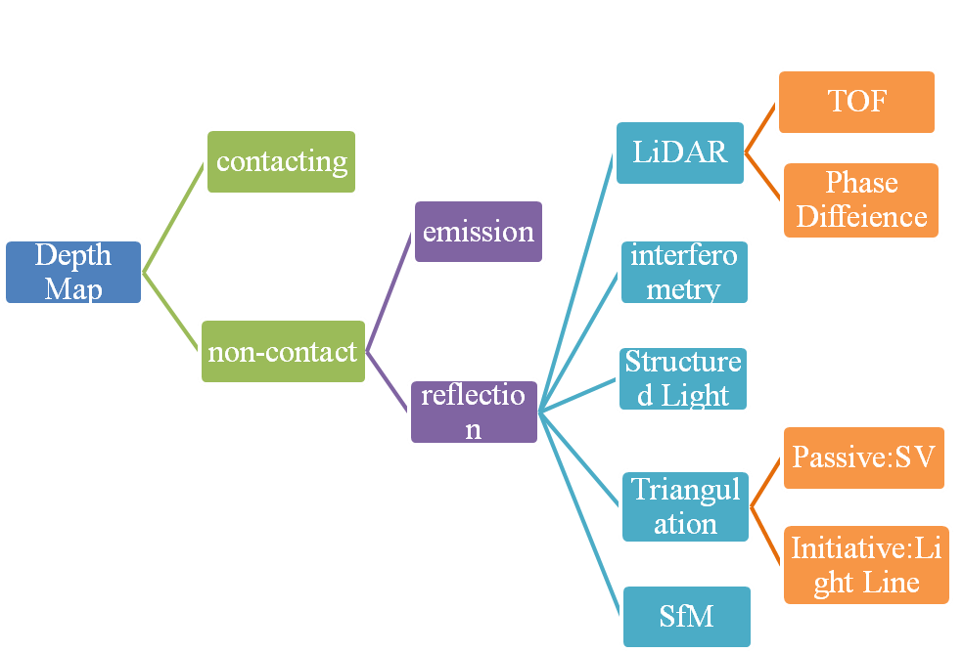
I. Overwater Depth Information Acquisition Method

Slide 4
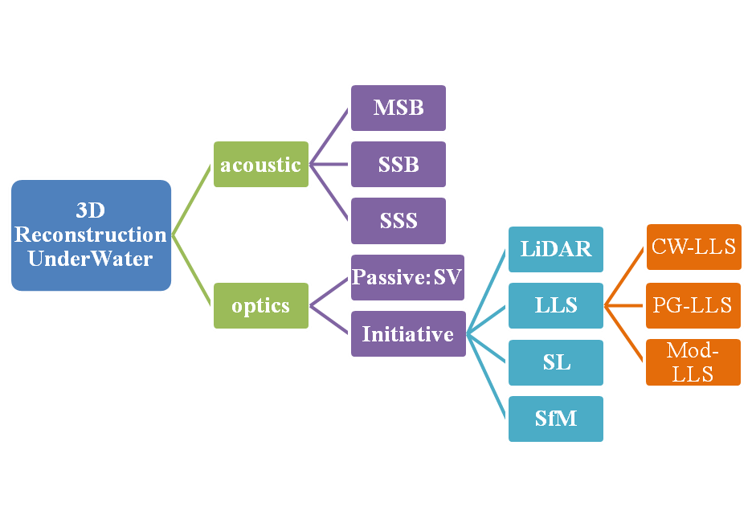
Ⅱ. Underwater 3D Reconstruction Method

Slide 5
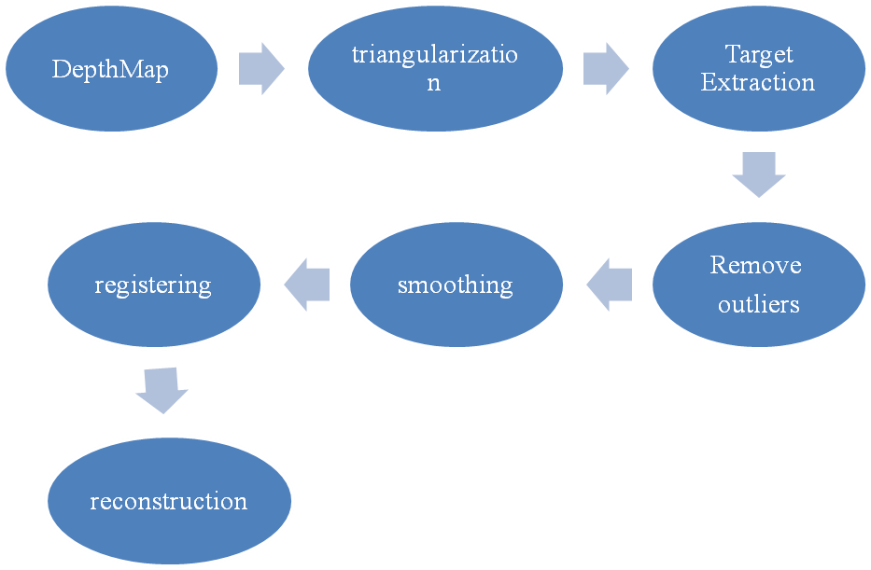
Ⅲ. The Flow of Underwater 3D Reconstruction
Light Detection and Ranging(LiDAR)

Slide 6
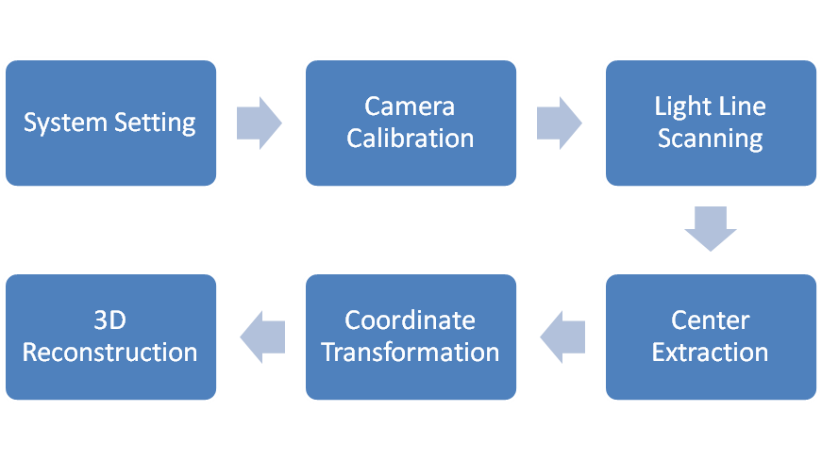
Laser Line Scanning(LLS)

Slide 7
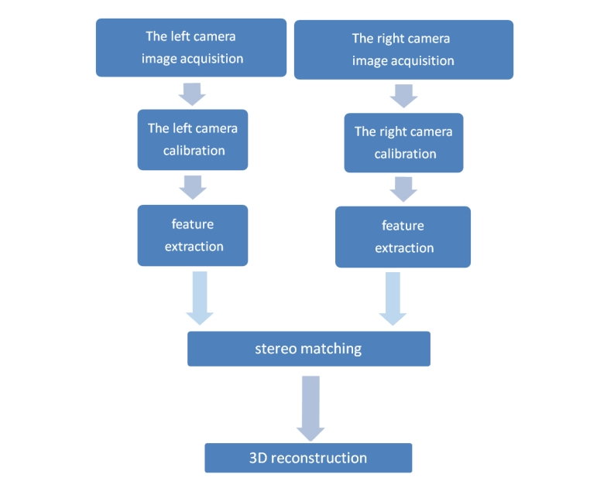
Stereo Vision(SV)

Slide 8
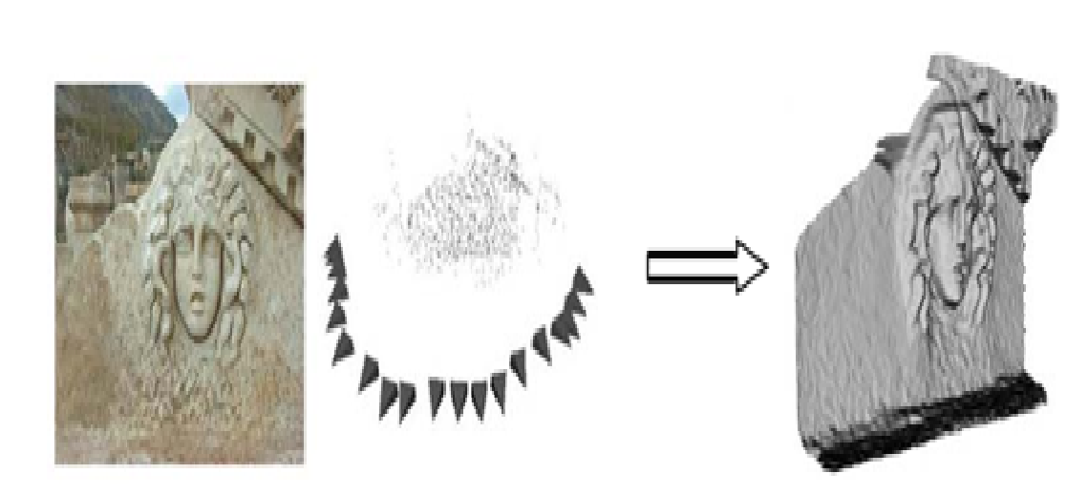
Structure from Motion(SfM)
Image acquisition
Camera calibration
Feature extraction
Stereo matching
3D reconstruction

Slide 9
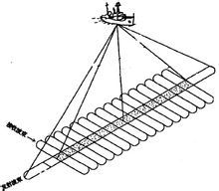
Multibeam Sonar(MBS)

Slide 10
Ⅳ.Survey
Literature Arrangement (before October 1 )reference details.pdf
Literature Arrangement (after October 1 )水下三维重建方法调研报告.pdf

Slide 11
Ⅴ. Future Work
深入研究下线激光扫描进行三维重建的原理与细节
设计实验方案

Slide 12
THANKS

